Slide 1




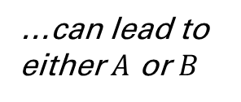

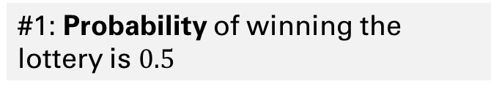

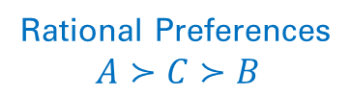

Based on current information
Best of the best
…can lead to either $A$ or $B$
Win ₹10 Crore
Outcome $A$
…the most-preferred
…unlikely
Buy Lottery Ticket
Action 1
Rational Preferences
$$A≻C≻B$$
Outcome $B$
Lose ₹1000
Evaluate
Compare
Choose
Decision-maker
…$C$ better than $B$
Don’t Buy
Action 2
Outcome $C$
₹0
Best of the worst
What information is missing?
#1: Probability of winning the lottery is $0.5$
Does this change your decision?
SECTION 1
The Single-Person Decision Problem
#2: The lottery ticket costs ₹1 and winning gives you ₹1000 Crore
TOPIC 1
The Rational Choice Paradigm
Class 5
Module 1: Actions, Outcomes, & Preferences
Module 2: The Payoff Function
Module 3: Continuous Action Spaces
Module 4: Decision Trees
Module 5: The Rational Player
…a coherent & precise language

Slide 2

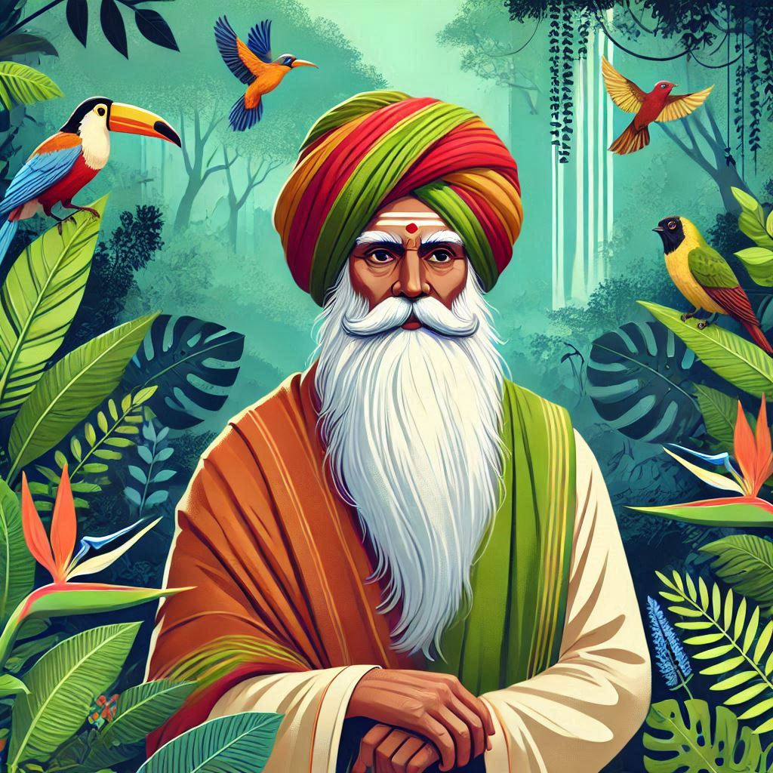
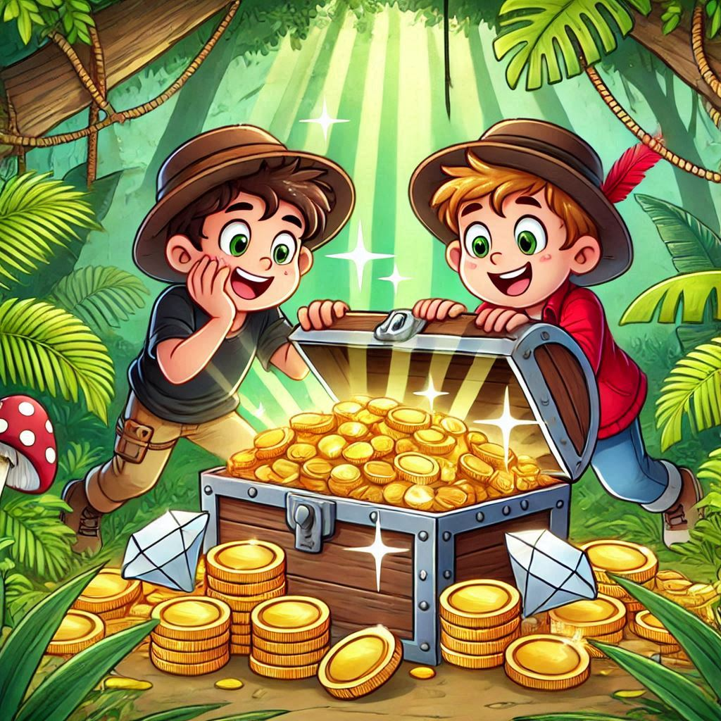

TOPIC 2
The Expected Utility Theory
Payoff associated with an action whose outcome is uncertain
Strategic thinking
Have we seen ‘Expectations’ & ‘Beliefs’ before?
SECTION 1
The Single-Person Decision Problem
= Payoff
TOPIC 1
The Rational Choice Paradigm
Decision-making under uncertainty
Class 5
Module 1: Actions, Outcomes, & Preferences
Module 2: The Payoff Function
Module 3: Continuous Action Spaces
Module 4: Decision Trees
Module 5: The Rational Player
…a coherent & precise language

Slide 3
The Single-Person Decision Problem
REVIEW
Ordinal construct
Doesn’t capture the intensity of the preferences, only the ranking
Best action
Actions
Outcomes
Payoff
No uncertainty
$$A=\left\{S, G, F\right\}$$
$$X=\left\{s, g, f\right\}$$
$$v\left(S\right)=10$$
$$v\left(G\right)=3$$
$$v\left(F\right)=7$$

Slide 4

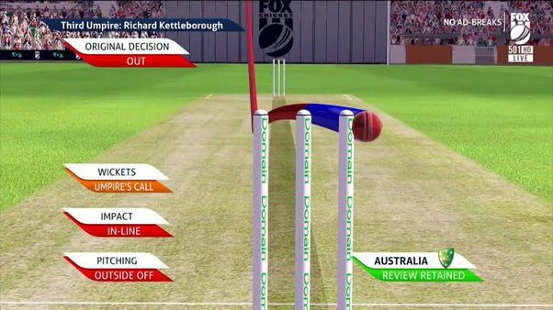

MODULE 1
Uncertain Outcomes
& Lotteries
DRS?
Carry?
…generalization of Topic 1
One Action, Multiple Outcomes
Weather
Power cuts
Traffic
Lack of information
Modeling Uncertainty
WiFi outages
Health
Economic conditions
Natural events
Stock market fluctuations
Mood

Slide 5


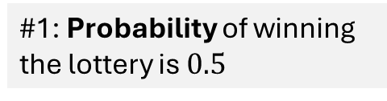
Multiple Outcomes
The Single-Person Decision Problem
More demanding—
All outcomes
Likelihood of each outcome
Action
Outcome
Payoff
Outcomes
$$x_{1}∈X$$
$$u\left(x_{1}\right)$$
How do we assign a payoff to an action with uncertain outcomes?
$$p\left(x_{1}\right)$$
OR
$$a∈A$$
$$x_{2}∈X$$
$$u\left(x_{2}\right)$$
$$p\left(x_{2}\right)$$
$$x∈X$$
$$u\left(x\right)$$
EUT: a framework to assign payoffs to actions when there’s uncertainty over outcomes
$$p\left(x_{3}\right)$$
OR
$$x_{3}∈X$$
$$u\left(x_{3}\right)$$
Modeling Uncertainty
$$\sum_{k}^{n}{p\left(x_{k}\right)}=1$$
#1: Probability of winning the lottery is $0.5$

Slide 6

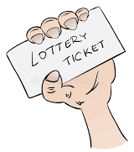
Buying a Lottery Ticket
EXAMPLE
Actions
$$A=\left\{B, N\right\}$$
Outcome
Nothing changes
Payoff
$$v\left(N\right)=0$$
$$p\left(x_{1}\right)$$
$$p\left(x_{3}\right)$$
Outcome 1
Lose
$$p\left(x_{2}\right)$$
Outcome 3
Win ₹1 Crore
Payoff
$$u\left(x_{3}\right)$$
Price: ₹1000
Payoff
$$u\left(x_{1}\right)$$
Outcome 2
Win ₹1 Lakh
Compare?
Payoff
$$u\left(x_{2}\right)$$
Payoff
$$v\left(B\right)= ?$$
Beyond decision-maker’s control

Slide 7

Funding a Defense Project
EXAMPLE
Actions
$$A=\left\{F, N\right\}$$
Outcome
Nothing changes
Payoff
$$v\left(N\right)=0$$
$$p\left(x_{1}\right)$$
$$p\left(x_{3}\right)$$
Outcome 1
Success
$$p\left(x_{2}\right)$$
Outcome 3
Failure
Outcome 2
Moderate benefit
Payoff
$$v\left(F\right)= ?$$

Slide 8


Decision Tree for Multiple Outcomes
NATURE

Slide 9


A Decision Tree: One Action, One Outcome
REVIEW
$$A=\left\{S, G, F\right\}$$
Action
$$10$$
Set of Actions
$$S$$
$$G$$
$$X=\left\{s, g, f\right\}$$
Player
$$7$$
Payoff
Set of Outcomes
$$F$$
Decision node
$$3$$
$$s≻f≻g$$
Preference Relations
Left to right
Terminal node
(Outcome)

Slide 10

Decision Tree for Multiple Outcomes
EXAMPLE
Decision Problem: Invest in a drug development method
The decision-maker chooses an action.
Action 1: Conventional method
Uncertainty
…but who selects the outcome of that action?
Outcome 1: Success. The drug passes trials and gains approval for the market. Probability 70%. Payoff: Rs. 100 crores.
Outcome 2: Failure. The drug fails trials and is not approved for the market. Probability 30%. Payoff: Rs. -20 crores (due to sunk costs).
Action 2: Innovative method
Uncertainty
Outcome 1: Breakthrough. The drug performs exceptionally, gaining approval and premium market interest. Probability 30%. Payoff: Rs. 200 crores.
Outcome 2: Standard success. The drug passes trial, but without exceptional performance or market interest. Probability 30%. Payoff: Rs. 80 crores.
Outcome 3: Failure. The drug fails trials and is not approved. Probability 40%. Payoff: Rs. -40 crores (higher losses due to increased research costs).

Slide 11
Decision Tree for Multiple Outcomes
The decision-maker chooses an action
…but who selects the outcome of that action?
EXAMPLE
…not rational
Nature
$$100$$
Action 2: Innovative method ($I$)
Outcome 1 (Breakthrough)
Probability: 30%
Payoff: Rs. 200 crores
Outcome 2 (Approved)
Probability: 30%
Payoff: Rs. 80 crores
Outcome 3 (Not approved)
Probability: 40%
Payoff: Rs. -40 crores
Action 1: Conventional method ($C$)
Outcome 1 (Approved)
Probability: 70%
Payoff: Rs. 100 crores
Outcome 2 (Not approved)
Probability: 30%
Payoff: Rs. -20 crores
$$0.7$$
$$A=\left\{C, I\right\}$$
Approved
$$N$$
2 Outcomes
$$0.3$$
A pseudo decision node
Not approved
$$−20$$
$$C$$
Conventional
Decision-maker
$$200$$
$$I$$
$$0.3$$
Breakthrough
Innovative
3 Outcomes
$$0.3$$
Approved
$$80$$
$$N$$
$$0.4$$
The sum of probabilities of all ‘actions’ of Nature is 1.
Each ‘action’ of Nature has a non-negative probability.
Root node
(Decision node)
Not approved
$$−40$$

Slide 12

A Lottery
…not rational
Nature
$$100$$
Lottery: A probability distribution over outcomes
$$0.7$$
$$A=\left\{C, I\right\}$$
$$N$$
Lottery
2 Outcomes
$$0.3$$
$$−20$$
$$C$$
Decision-maker
$$200$$
$$I$$
$$0.3$$
3 Outcomes
$$0.3$$
$$80$$
$$N$$
$$0.4$$
Root node
(Decision node)
Lottery
Purchasing a lottery
$$−40$$

Slide 13

A Simple Lottery
Modeling Uncertainty
A simple lottery over outcomes $X=\left\{x_{1},x_{2},…, x_{n}\right\}$ is defined as a probability distribution $p=\left(p\left(x_{1}\right),p\left(x_{2}\right), …,p\left(x_{n}\right)\right)$, where $p\left(x_{k}\right)≥0$ is the probability that $x_{k}$ occurs and $\sum_{k=1}^{n}{p\left(x_{k}\right)}=1$.
Notation
$$X$$ | Set of outcomes of all available actions
$x_{1}$, $x_{2}$, …$x_{n}$ | Individual outcomes (Elements of $X$)
$$p\left(x_{k}\right)$$ | Probability that outcome $x_{k}$ will occur
Each action has its own lottery.

Slide 14

A Compound Lottery
EXAMPLE
Nature moves multiple times in a row…
Decision Problem: Invest in a drug development method
Action 1: Conventional method
Outcome 1: Success. The drug passes trials and gains approval for the market. Probability 70%. Payoff: Rs. 100 crores.
  Outcome 1.1: Market acceptance. Highly effective. Probability 80%. Payoff: Rs. 100 crores.
  Outcome 1.2: Market rejection. Adverse effects. Probability 20%. Payoff: Rs. -40 crores.
Outcome 2: Failure. The drug fails trials and is not approved for the market. Probability 30%. Payoff: Rs. -20 crores (due to sunk costs).
Action 2: Innovative method

Slide 15


A Compound Lottery
EXAMPLE
$$0.7×0.8=0.56$$
$$100$$
$$0.8$$
Simple Lottery
$$N$$
Action 1: Conventional method ($C$)
Outcome 1 (Approved)
Probability: 70%
Payoff: Rs. 100 crores
Outcome 2 (Not Approved)
Probability: 30%
Payoff: Rs. -20 crores
Action 1: Conventional method ($C$)
Outcome 1 (Approved)
Probability: 70%
Outcome 1.1 (Accepted)
Probability: 80%
Payoff: Rs. 100 crores
Outcome 1.2 (Rejected)
Probability: 20%
Payoff: Rs. -40 crores
Nature
$$100$$
$$0.2$$
$$0.7$$
$$−40$$
$$N$$
Simple Lottery
$$0.7×0.2=0.14$$
2 Outcomes
$$0.3$$
$$A=\left\{C, I\right\}$$
$$−20$$
$$C$$
$$200$$
Player
$$I$$
$$0.3$$
3 Outcomes
$$0.3$$
The player should focus only on the probabilities of final outcomes resulting from each action.
$$80$$
$$N$$
$$0.4$$
Root node
(Decision node)
$$−40$$
Compound → Simple

Slide 16



A Degenerate Lottery
REVIEW
One action, one outcome
Study for Exam
Play Games
Socialize with Friends
Actions
Better Prepared for Exam
Immediate Relaxation
Build Relationships
Outcomes
$$A=\left\{S, G, F\right\}$$
$$X=\left\{s, g, f\right\}$$
$$s≿f≿g$$
Set of Actions
Set of Outcomes
Preference Relations

Slide 17
A Degenerate Lottery
REVIEW
One action, one outcome
$$A=\left\{S, G, F\right\}$$
$$X=\left\{s, g, f\right\}$$
Set of Actions
Set of Outcomes
Probability distribution between outcomes for action $S$
$$p_{S}=\left(p\left(s\right), p\left(g\right), p\left(f\right)\right)$$
$$p_{S}=\left(1, 0, 0\right)$$
A degenerate lottery is a simple lottery with a single guaranteed outcome.
Probability distribution between outcomes for action $G$
$$p_{G}=\left(p\left(s\right), p\left(g\right), p\left(f\right)\right)$$
$$p_{G}=\left(0, 1, 0\right)$$
Probability distribution between outcomes for action $S$
…generalization of Topic 1
$$p_{F}=\left(p\left(s\right), p\left(g\right), p\left(f\right)\right)$$
$$p_{F}=\left(0, 0, 1\right)$$

